Slide 1



Building with the Claude API (Backend & Integration)
www.zarantech.com
© Copyright 2026, ZaranTech LLC. All rights reserved.

Slide 2


Disclaimer
This presentation, including examples, images, and references are provided for informational purposes only.
Complying with all applicable copyrights laws is the responsibility of the user.
Without limiting the rights under copyright, no part of this document may be reproduced, stored or introduced into a retrieval system, or transmitted in any form or by any means.
Credits shall be given to the images taken from the open-source and cannot be used for promotional activities.
© Copyright 2026, ZaranTech LLC. All rights reserved.

Slide 3

Agenda
Understand core Claude API mechanics, including authentication and model selection.
Configure secure environment variables for your application development workspace.
Implement dynamic prompt templates with programmatic system and user instructions.
Maintain robust conversation state across multiple user interaction turns.
Evaluate model suggestions critically and justify architectural integration choices.
© Copyright 2026, ZaranTech LLC. All rights reserved.

Slide 4
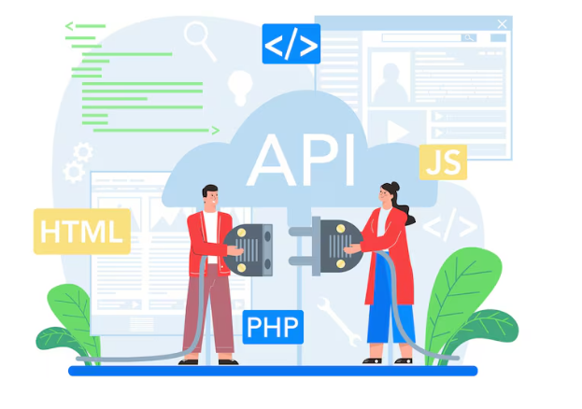
Exercises in This Module
Exercise 10: Configure a key in .env and make a first call. 12 minutes.
Exercise 11: Build a CLI with a structured prompt template. 22 minutes.
Exercise 12: Manage conversation history by relevance. 18 minutes.
This module needs an API key with credit. Set it up before you start.
© Copyright 2026, ZaranTech LLC. All rights reserved.

Slide 5
Overview of Claude API
The Claude API enables developers to integrate advanced language capabilities natively.
It operates using a standardized RESTful interface for straightforward backend communication.
There is a single messages endpoint. The model is a parameter in the request body.
Responses are delivered in JSON format for easy parsing and manipulation.
The API supports streaming responses for real-time application user experiences.
© Copyright 2026, ZaranTech LLC. All rights reserved.

Slide 6
API Authentication Principles
Every API request requires a unique cryptographic key for reliable authentication.
Send the key in the x-api-key header, alongside a required anthropic-version header.
Never hardcode authentication keys directly within your application source files.
Rotate your credentials periodically to maintain strict access control standards.
Monitor dashboard usage regularly to detect any unauthorized request anomalies.
© Copyright 2026, ZaranTech LLC. All rights reserved.

Slide 7
Choosing the Right Model
Claude offers a diverse family of models tailored for different complexities.
Haiku is optimized for incredible speed and highly cost-effective tasks.
Sonnet provides an excellent balance between cognitive performance and latency.
Opus delivers maximum intelligence for highly complex reasoning and coding.
Select by tier, then read the current version identifier from configuration.
© Copyright 2026, ZaranTech LLC. All rights reserved.

Slide 8
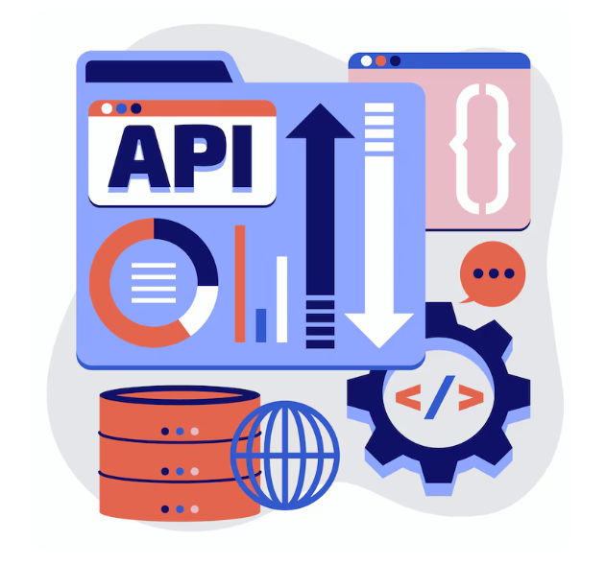
Key API Parameters
Max tokens define the absolute upper limit for generated text responses.
Temperature controls the randomness and creative variance of the model output.
A lower temperature yields highly deterministic and analytically precise results.
Top-K and Top-P parameters further refine the token selection probability distribution.
Stop sequences force the model to halt generation at specific characters.
© Copyright 2026, ZaranTech LLC. All rights reserved.

Slide 9
Setting Up Environment Variables
Environment variables isolate sensitive configuration data securely from your codebase.
Create a local configuration file to store your specific API keys.
Add this configuration file to your version control exclusion list immediately.
Use language-specific libraries to load these variables into memory securely.
Cloud deployment platforms provide dedicated secure vaults for external variable management.
© Copyright 2026, ZaranTech LLC. All rights reserved.

Slide 10
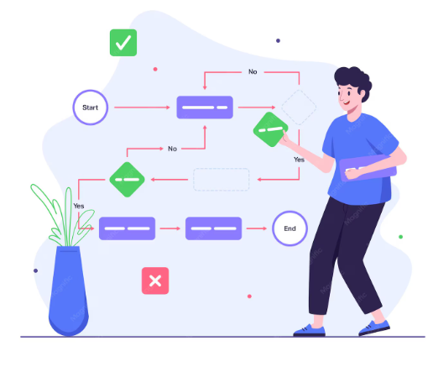
Basic Request and Response Flow
Initialize the official Claude SDK within your Python or Node environment.
Construct a message object containing your specific role and textual content.
Send the asynchronous request to the designated API endpoint securely.
Extract the generated text content from the returned JSON response object.
Implement robust error handling to manage rate limits and network timeouts.
© Copyright 2026, ZaranTech LLC. All rights reserved.

Slide 11
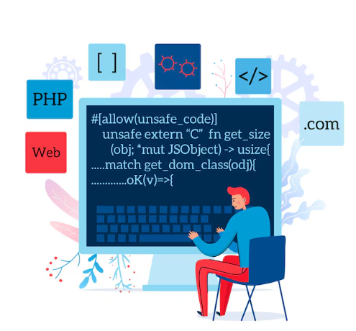
Prompt Engineering in Code
Programmatic prompts require structured formatting unlike standard web interface interactions.
Backend logic must construct prompts dynamically based on incoming application state.
Clear separation between instructions and data prevents unexpected model behaviors.
Version control your prompt definitions alongside your standard application code.
Test prompt variations systematically to measure output consistency and accuracy.
© Copyright 2026, ZaranTech LLC. All rights reserved.

Slide 12

Encoding System and User Instructions
System prompts define the core persona, boundaries, and rules for Claude.
User instructions represent the specific immediate task or query to resolve.
Always place overarching constraints within the dedicated system prompt parameter.
Keep user prompts strictly focused on the current dynamic input data.
This strict separation enhances security against potential prompt injection attacks.
© Copyright 2026, ZaranTech LLC. All rights reserved.

Slide 13
Shaping the Response
Messages must alternate between the user role and the assistant role.
Two user messages in a row is a common cause of a confusing API error.
You can start the assistant's reply for it, which constrains the format tightly.
Prefilling an opening brace is a reliable way to get JSON and nothing else.
A system prompt is a top-level parameter, not the first message in the list.
© Copyright 2026, ZaranTech LLC. All rights reserved.

Slide 14

Managing Structured Prompt Templates
Templates allow developers to reuse common prompt structures across multiple requests.
Use modern string interpolation to inject variables into predefined text blocks.
Maintain separate template files for cleaner code organization and easier updates.
Utilize standard formatting structures like XML tags to segment prompt sections.
Validate template outputs thoroughly before sending them to the live API.
© Copyright 2026, ZaranTech LLC. All rights reserved.

Slide 15
Inserting Dynamic Variables
Dynamic variables bridge the gap between user input and backend prompts.
Sanitize all user-provided variables before insertion to maintain application security.
Inject relevant contextual data like user history or retrieved database records.
Ensure variable data strictly adheres to expected formatting and length limits.
Log the final assembled prompts during debugging to verify correct insertion.
© Copyright 2026, ZaranTech LLC. All rights reserved.

Slide 16

Handling Tokens and Truncation
Every API request is constrained by strict maximum token processing limits.
Use dedicated tokenizer libraries to count tokens before sending the request.
Implement intelligent truncation strategies to shorten text without losing critical meaning.
Prioritize retaining the most recent or relevant information during content truncation.
Monitor token usage continuously to optimize ongoing operational API costs.
© Copyright 2026, ZaranTech LLC. All rights reserved.

Slide 17

Managing Long-Context Prompts
Claude supports massive context windows for analyzing extensive documents simultaneously.
Place the most crucial instructions at the very end of long prompts.
Structure long texts with clear headings and distinct structural XML markers.
Provide explicit indexing or reference points within the provided large context.
Avoid including irrelevant filler data that might distract the model's attention.
© Copyright 2026, ZaranTech LLC. All rights reserved.

Slide 18
Context Management Strategies
APIs are inherently stateless and forget previous interactions immediately after completion.
Developers must manually supply the necessary conversational context with every request.
Careful context management prevents exceeding limits while maintaining conversational coherence.
Determine exactly how much historical data is strictly necessary for success.
Balance context richness against the increased latency and higher processing costs.
© Copyright 2026, ZaranTech LLC. All rights reserved.

Slide 19

Preserving Conversation State
Assign unique session identifiers to track individual user conversation threads effectively.
Store conversation logs securely within a robust backend database infrastructure.
Append each new user message and model response to the active array.
Fetch and inject this organized array structure into subsequent API calls.
Implement automatic expiration policies for inactive conversation sessions to save storage.
© Copyright 2026, ZaranTech LLC. All rights reserved.

Slide 20
Passing Documents and Code Snippets
Inject entire documents directly into the prompt using clear delimiting tags.
For code snippets, explicitly state the programming language for better formatting.
Group related documents together chronologically or logically to aid model comprehension.
Extract and pass only the relevant document chunks to drastically save tokens.
Ask the model to cite specific lines when analyzing provided code.
© Copyright 2026, ZaranTech LLC. All rights reserved.

Slide 21

Optimizing Context Limits
Implement a sliding window approach to drop the oldest conversation turns.
Summarize older interactions periodically to retain core meaning using fewer tokens.
Use semantic search to retrieve only contextually relevant data chunks dynamically.
Compress repetitive code patterns before sending them to the API endpoint.
Constantly evaluate if your chosen context optimization degrades the output quality.
© Copyright 2026, ZaranTech LLC. All rights reserved.

Slide 22
Reusing a Stable Prefix: Prompt Caching
Long prompts often repeat a large, unchanging prefix on every request.
Caching that prefix means you are not billed to reprocess it each time.
Order matters: put the stable material first and the variable material last.
It is a cost and latency optimisation, not a way to raise a context limit.
Check the current caching mechanics in the API documentation before you rely on them.
© Copyright 2026, ZaranTech LLC. All rights reserved.

Slide 23

Model Context Protocol (MCP) Basics
MCP is an open standard connecting AI models securely to external data.
It standardizes how models request and consume information from distinct systems.
MCP eliminates the need to build custom integration bridges from scratch.
It creates a unified framework for seamless tool and data orchestration.
This protocol dramatically accelerates the development of complex agentic AI applications.
© Copyright 2026, ZaranTech LLC. All rights reserved.

Slide 24
Integrating MCP Tools
Configure basic tools to grant Claude specific actions like database queries.
Define exact input schemas so the model understands required tool parameters.
The model decides autonomously when invoking a specific tool is appropriate.
Your backend executes the chosen tool and returns results to Claude.
Handle tool execution failures gracefully to maintain a stable user experience.
© Copyright 2026, ZaranTech LLC. All rights reserved.

Slide 25
Activity - Reviewing API Architecture
Compare your Exercise 11 CLI against the supplied reference implementation.
Analyze your own code for prompt injection risk in the untrusted input path.
Examine the context management strategy you chose in Exercise 12, and its cost.
Identify flaws in how your own design handles session state persistence.
Prepare notes on efficiency, security and scalability for your capstone design.
© Copyright 2026, ZaranTech LLC. All rights reserved.

Slide 26

Activity - Decision and Justification
Decide which of the suggestions you received you will accept, and say why.
Compare your chosen approach against latency, cost and complexity.
Explain how your design handles context persistence and untrusted input.
Write the decision down. It becomes the design note in your capstone README.
© Copyright 2026, ZaranTech LLC. All rights reserved.

Slide 27

Key Takeaways
We explored core API concepts including secure authentication and endpoint routing.
You learned to implement programmatic prompt engineering using dynamic variable templates.
We covered vital strategies for handling tokens and managing long contexts.
We discussed preserving state and utilizing the Model Context Protocol effectively.
You practiced making architectural decisions by accepting and justifying specific suggestions.
© Copyright 2026, ZaranTech LLC. All rights reserved.

Slide 28
Thank You
For more informative Videos, Subscribe to our YouTube Channel
www.zarantech.com
© Copyright 2026, ZaranTech LLC. All rights reserved.

